Slide 1
Physics 598BP
Lec 1:
https://www.youtube.com/watch?v=wglcIWF3aeA&feature=youtu.be
Today: Fluorescence
What is it?
Why is it good?
Basic Set-up
Measuring lifetime– two ways (Lifetime and Phase Modulation)
3D sectioning (confocal microscopy)
Two-photon microscopy (confocal)

Slide 2
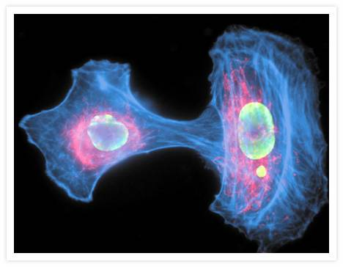
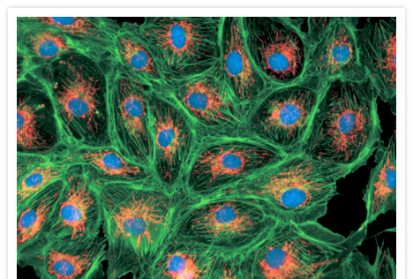
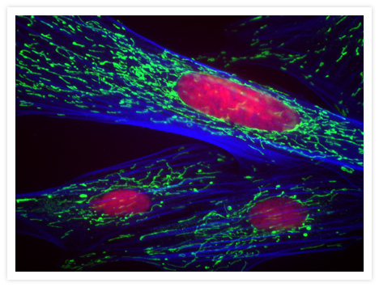
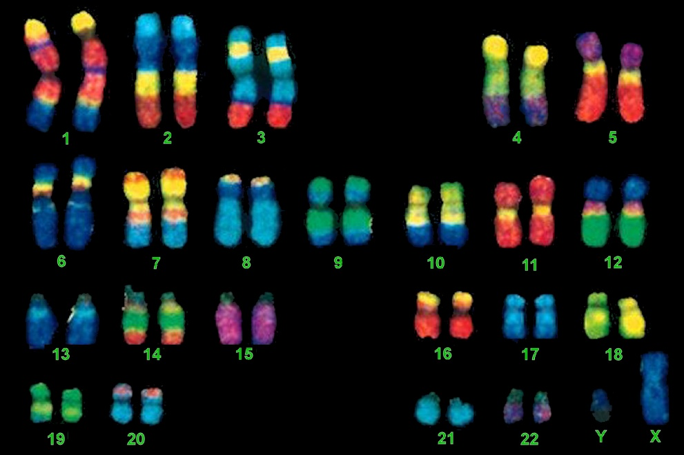
Fluorescence: get beautiful pictures
www.invitrogen.com

Slide 3
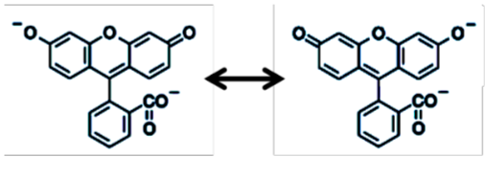
What is fluorescence?
Shine light in, gets absorbed, loses a little bit of energy,
reemits at longer wavelength
Light In
Light Out
Fluorescein
Not all molecules fluoresce.
Many absorbs light and then energy is lost to random vibrations (heat)
Only those with delocalized electrons can absorb and then remit energy.

Slide 4
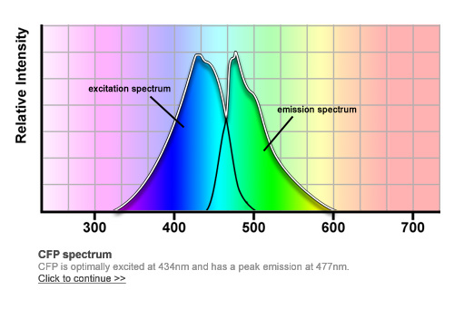
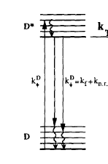
What is fluorescence?
Shine light in, gets absorbed, reemits at longer wavelength
Why is excitation spectra & emission spectra (almost) mirror images of the other??
Stokes Shift (10-100 nm)
Light In
Excitation
Spectra
Emission
Spectra
Light Out
Thermal
Relaxation
[psec]
Fluorescence
& + non-radiative
[nsec]
Absorption
[ftsec]
k⬆
k⬇= k_{f} +k_{n.r.}
Fluorescence
y = e
-τ/τ_{o}
Thermal relaxation
[psec]
τ_{o} = 1/k⬇= 1/(k_{f} +k_{n.r.})
Time (nsec)
Photobleaching Important: Dye emits 10⁵→ 10⁷ photons, then dies!

Slide 5
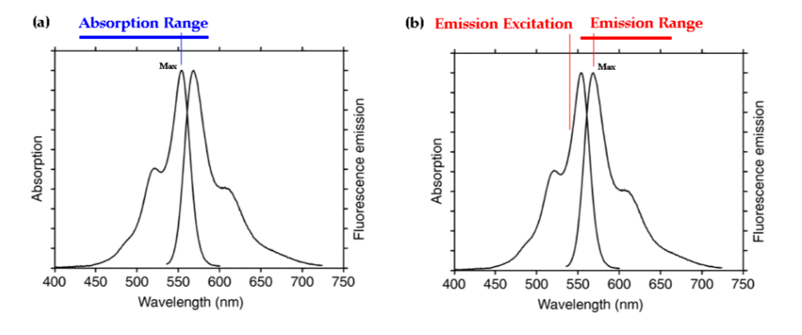
Where do you excite and where do you collect emission?

Slide 6
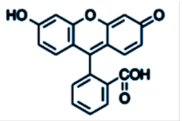
Fluorescence: Can be pH sensitive
Deprotonated:
High pH
Protonated:
Low pH
Equilibrium point—pK_{a}: for fluorescein it’s about 7 (?)

Slide 7
Why fluorescence? Why so good?
Super-sensitive: see single fluorescent dye!
Why?
Answer: It’s a dark-field technique– shine light and w/o fluorophore being there, (ideally) see nothing. [Recall, that the noise associate with taking a measurement is proportional to how much there is: want to weigh something—it’s hard to do really precisely if object weighs a lot; easier to do if you’re weighing a light object. A bright-field technique has a lot of noise.
2. Lots of different labels for different objects.
Get specificity and see many different objects on same sample.
3. Problem w fluorescence:
must label with a fluorophore
– sometimes, this is difficult/impossible.

Slide 8
Basic Set-up of Fluorescence Microscope
(Eye or Electronic Detectors)
CCD, EMCCDs, PMTs, APDs
Reflects blue light, transmits green
(Lasers, Arc Lamps)
High NA objectives
(up to NA=1.49)
Fluorophore:
Absorbs blue, emits in green.
Notice that you see nothing if no fluorescence;
it’s a reflection technique plus color discrimination
Little background → can see little (not much) signal.
Semwogerere & Weeks, Encyclopedia of Biomaterials and Biomedical Engineering, 2005

Slide 9
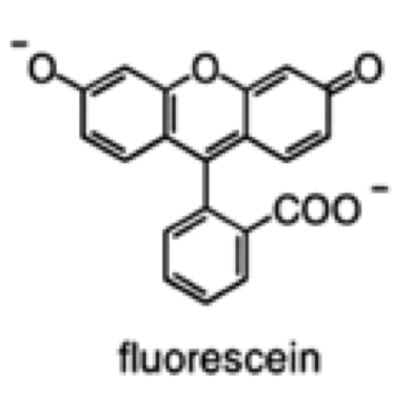
Fluorophores & Quantum Yield q.y. = # photons out/photons in.
Have ≥ 1 electron that is free to move. Excitation light moves e’s around, i.e. a dipole, and it can re-radiate, often with polarization.
Good dyes: QY ≈ 1;
Absorption ≈ 100,000 cm⁻¹M⁻¹
( A = εbc)
Thermal
relaxation
S₁
[Picosec]
k = k_{rad} + k_{n.r.}
τ = 1/k = τ_{rad} + τ_{n.r.}
QY = k_{rad}/(k_{rad} + k_{n.r})
S₀
Fluorescence (k_{rad} )
& Non-radiative (k_{n.r.})
Energy
Absorption
[Femtosec]
Thermal relaxation
[Picosec]

Slide 10
Photobleaching
Often Oxygen Dependent
Thermal
relaxation
Triplet State (?)
(Long lifetime: )
> 1μs
[O₂]
reaction
Non-Fluorescent state
Fluorescence
& Non-radiative
Photobleached?
Absorption
Thermal relaxation
Thermal
relaxation

Slide 11
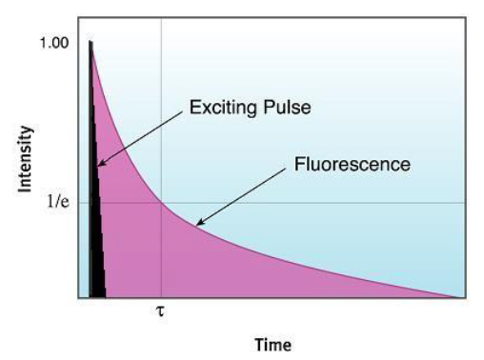
Measuring Lifetimes
Time-Domain & Frequency Domain
Fluorescence
y = αe
-t/τ
τ = 1/k⬇= 1/(k_{f} +k_{n.r.})
Time (nsec)
As long as excitation pulse very short compared to fluorescence lifetime, you don’t have to correct for it.
Measure the lifetime(s)

Slide 12
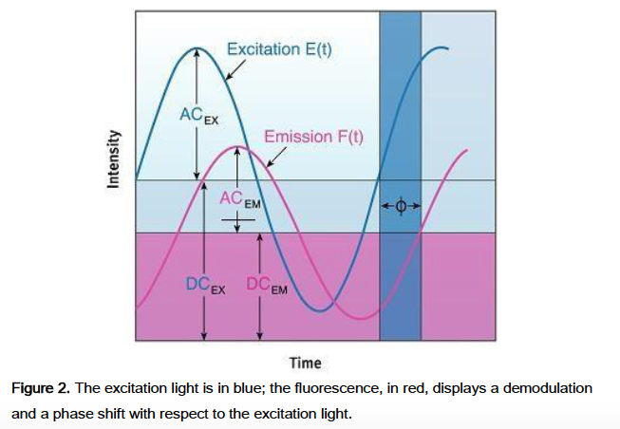

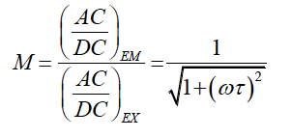

Measuring Lifetimes
Time-Domain & Frequency Domain
Excitation light Intensity:
Where E(t) and E₀ are the intensity at time t, 0;
M_{E} = modulation factor, ω=2πν
The result is a phase shift & demodulation
Measure them at different modulation frequencies (typically 15-20).

Slide 13
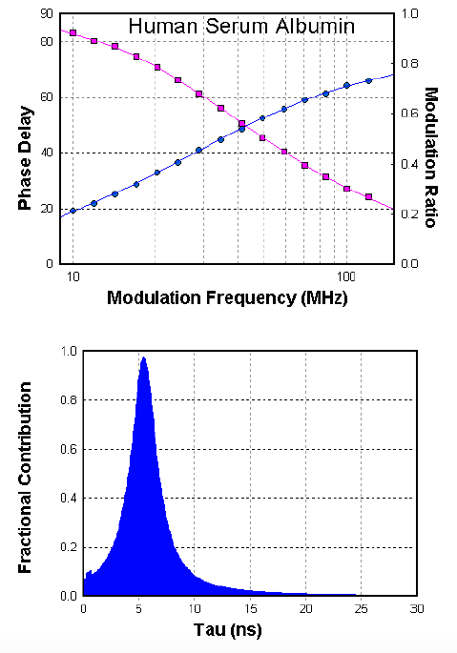
Experimental data and analysis for Frequency Domain measurements
Can get not just one lifetime, but several, indicating some heterogeneity. Especially in case of a (biological) cell.

Slide 14
FRET: measuring conformational changes of (single) biomolecules
FRET
FRET depends sharly on distance, R⁻⁶; useful for 20-80Å
Distance dependent interactions between green and red light bulbs can be used to deduce the shape of the scissors during the function.

Slide 15
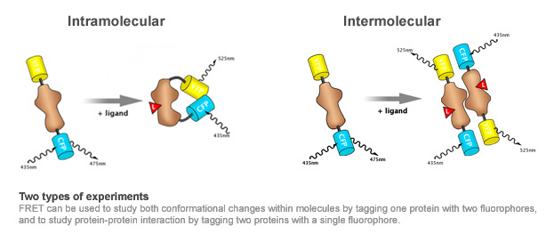
FRET is so useful because
R_{o} (2-8 nm) is often ideal
Bigger R_{o} (>8 nm)
can use FIONA, PAM. STORM -type techniques

Slide 16
Fluorescence Resonance Energy Transfer (FRET)
Spectroscopic Ruler for measuring nm-scale distances, binding
E
Energy
Transfer
R_{o} ≈ 50 Å
Donor
Acceptor
R (Å)
Time
Dipole-dipole Distant-dependent
Energy transfer
Look at relative amounts
of green & red
Time

Slide 17
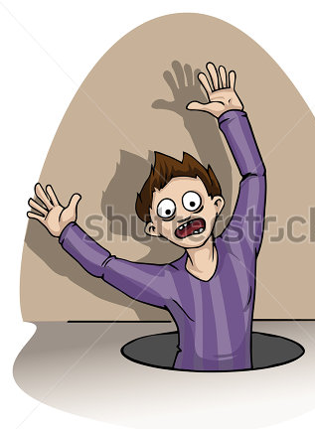
FRET Lifetimes w and w/o FRET
Think of it like you’re on a cliff, walking around randomly with a blindfold on, with holes of certain sizes on the floor. If you walk over one of these holes, you fall down to the ground.
The first hole you fall down and you emit a photon. You do this at a rate = k_{rad} (a certain number of times per second, so the rate k, has units of 1/time); the second hole you emit a bunch of phonons in the i.r., i.e. heat at a rate = k_{nonrad}; the third hole you fall down andpass through a room with a see-saw that you happen to hit which sends a friend, who is sitting on the other end, up to the same height on another cliff.
Your lifetime (Donor) lifetime
Without FRET
Your lifetime (Donor) lifetime
With FRET
k = k_{rad} + k_{n.r.}
τ = 1/k = τ_{rad} + τ_{n.r.}
QY = k_{rad}/(k_{rad} + k_{n.r})
k = k_{rad} + k_{n.r.} + k_{FRET}
τ = 1/k = τ_{rad} + τ_{n.r} + τ_{FRET}
QY = k_{rad}/(k_{rad} + k_{n.r} + k_{FRET})
Notice that the lifetime decreases in the presence of FRET. Furthermore, you can alter the size of the FRET rate—make the whole bigger or smaller. The bigger it is, the larger k_{FRET} is, the greater the decrease in your lifetime.

Slide 18
Class evaluation
1. What was the most interesting thing you learned in class today?
2. What are you confused about?
3. Related to today’s subject, what would you like to know more about?
4. Any helpful comments.
Answer, and turn in at the end of class.

